Slide 1
Deep Learning
Object Detection Session 7
Object detection is about classifying objects and define a bounding box around them.
( content has been taken from various authors and websites)
Notes:
4/3/2019
1

Slide 2
Todays Agenda
Segmentation
Faster R-CNN
Questions.

Slide 3
What is Segmentation ?
Segmentation: is a partition of an image into several "coherent" parts, but without any attempt at understanding what these parts represent.
Partitioning can be based on low-level cues such as color, texture and smoothness of boundary.
Semantic Segmentation: (Pixel Level Classification) attempts to partition the image into semantically meaningful parts, and to classify each part into one of the pre-determined classes.
Instance Segmentation: Identifies each unique object on the image.

Slide 4
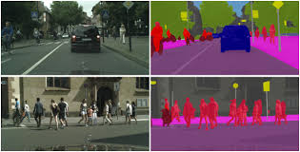
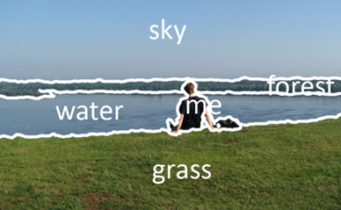
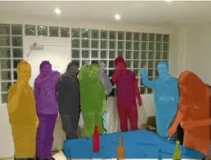
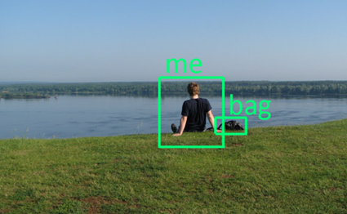
Segmentation
Semantic Segmentation
Instance Segmentation
Object Detection

Slide 5
Why is Semantic Segmentation Important ?
Semantic Segmentation is needed to have a complete Scene Understanding.
An increasing number of applications depend on inferring knowledge from imagery.
Eg: self-driving vehicles, human-computer interaction, virtual reality, Precision Agriculture etc.

Slide 6
Semantic Segmentation
Steps of Semantic Segmentation
Origin: is needed for context. It helps in making a prediction for a whole input.
Localization / Detection, which provide not only the classes but also additional information regarding the spatial location of those classes.
Semantic Segmentation achieves fine-grained inference, so that each pixel is labeled with the class of its enclosing object region.
Semantic segmentation requires
discrimination at pixel level .
mechanism to project the discriminative features learnt at different stages of the encoder onto the pixel space.

Slide 7
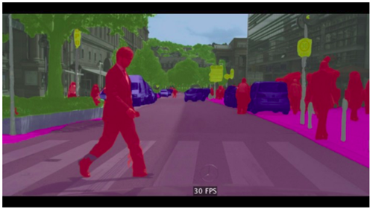
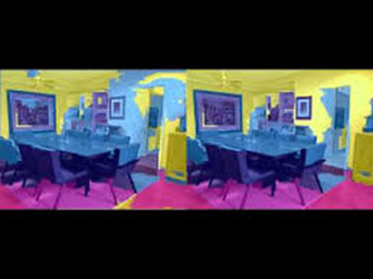
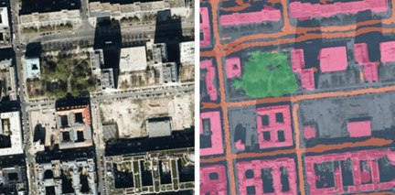

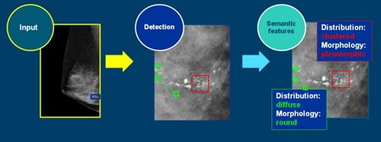
Road
Indoor
Detecting and Classifying Calcification regions in Mammographic Images.

Slide 8
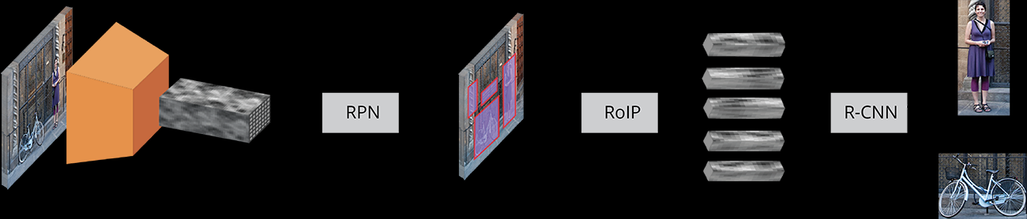
Faster R-CNN
1) Input Image:
The input images are represented as Height×Width×Depth tensors
2) Pre-Trained CNN
They are passed through a Pre-Trained CNN up until an intermediate layer, ending up with a convolutional feature map.
3) RPN: (Region Proposal Network)
Using the features that the CNN computed, it is used to find up to a predefined number of regions (bounding boxes), which may contain objects.
4) RoIP: (Region of Interest Pooling).
Performs Max Pooling on Inputs of non uniform size, and produces a fixed size feature map.
5) R-CNN
Classifies the content in the bounding boxes or discards it.
Adjusts the Bounding Box co-ordinates for a best fit.

Slide 9
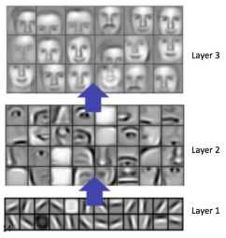
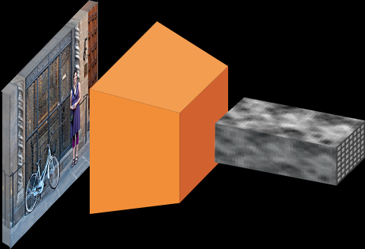
Pre Trained CNN.
(Could be VGG or ResNet or any other suitably trained CNN)
Each convolutional layer creates abstractions based on the previous information.
The first layers usually learn edges, the second finds patterns in edges in order to activate for more complex shapes and so forth. Eventually we end up with a convolutional feature map which has spatial dimensions much smaller than the original image, but greater depth.
The width and height of the feature map decrease because of the pooling,and the depth increases based on the number of filters the convolutional layer learns.
In its depth, the convolutional feature map has encoded all the information for the image while maintaining the location of the “things” it has encoded relative to the original image.

Slide 10
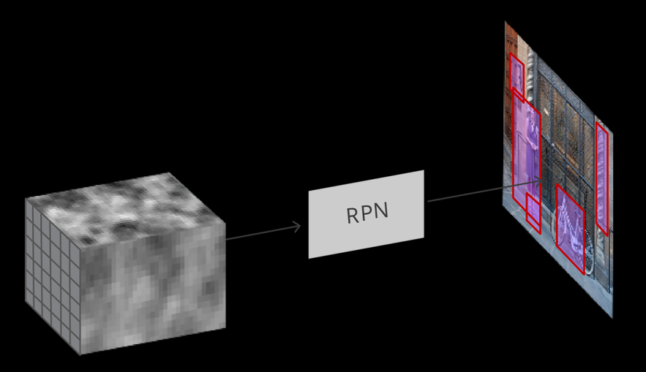
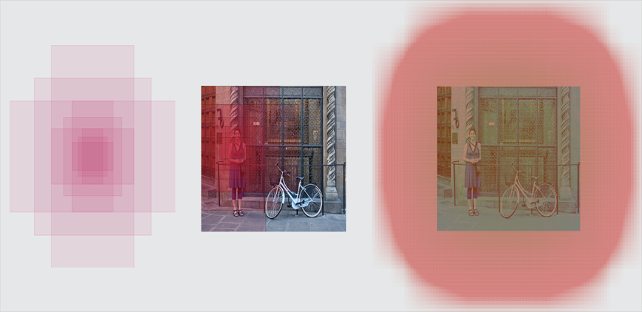
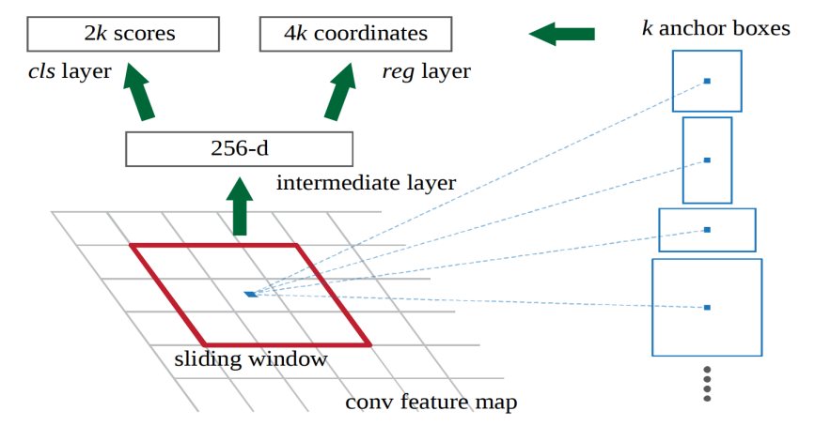
RPN: Region Proposal Map
The RPN, acts on the Feature Map generated by the pretrained CNN.
RPN is a 3x3 dimensional Block, that slides over the whole Feature Map.
Allows each pixel in the Feature Map, to be the center of the 3x3 region.
At each sliding-window location, multiple region proposals are simultaneously predicted.
Anchor:
It is always centered at the middle of the sliding window.
Each Anchor has a fixed scale and ratio.
Generally 9 anchors of different scales and Aspect Ratio are used.
Each Sliding Position has 9 Anchors.
The Anchors are applied to the Input Image.

Slide 11
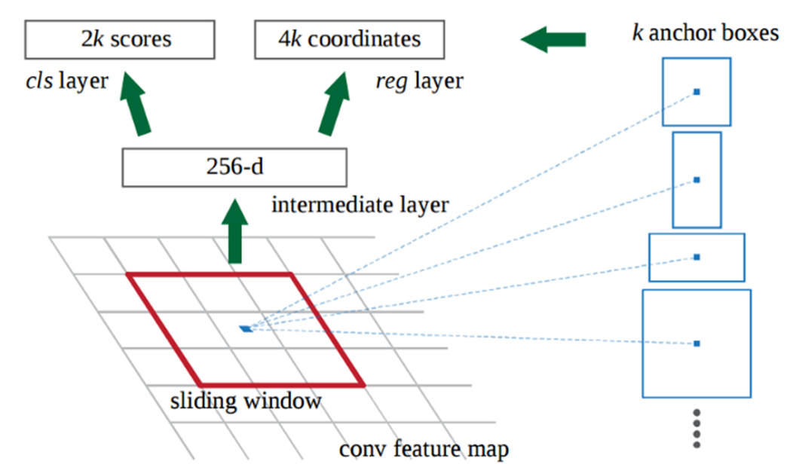
We use k=9 Anchor Boxes.
256-d: the Channels
cls : 2k each anchor box will
Have 2 prediction.
Reg 4k each anchor box will
Have 4 numbers (x,y,h,w).
Input: Feature Map ( 256/512/… Channels) , In the picture above, we have a depth of 256 Channels.
Sliding Window: On this we run a 3x3 sliding window, which will give us an output of 1x1x 256 feature Vector (256-d) .
cls layer: Classification layer, we output we two predictions per anchor: the score of it being background (not an object) and the score of it being foreground (an actual object).
At this point, we don’t care what class of object it is, only that it does in fact look like an object (and not background).
reg layer: Regression layer outputs 4 numbers (x,y, H,W).
These are wrt the Input Image. (x,y) are the center of the Anchor Box.

Slide 12
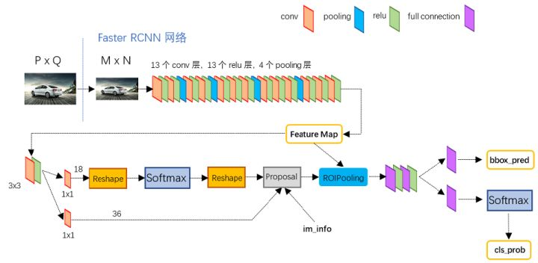
If an anchor box has an “objectness” score above a certain threshold, that box’s coordinates get passed forward as a region proposal.
Once we have our region proposals, we feed them straight into what is essentially a Fast R-CNN.

Slide 13
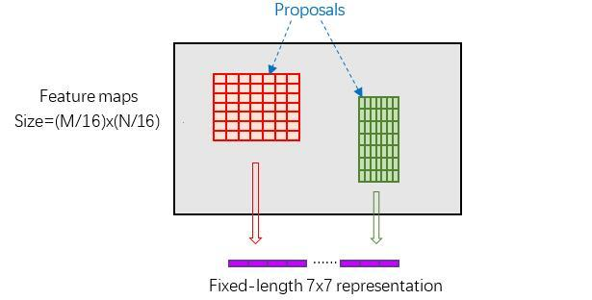
RoI Pooling
The RoI Pooling layer is responsible for collecting the proposal and calculating the proposal feature maps for delivery to the subsequent network.
Roll pooling layer has 2 inputs:
Original feature maps
Proposal boxes for RPN output (different sizes)

Slide 14
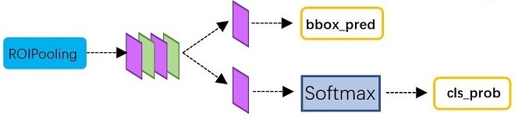
Classification:
Classification of proposals by full connection and softmax, to get Class probability.
Bounding Box regression on proposals to get a higher precision.

Slide 15
Next Topics
Mask R-CNN
YOLO
U-Nets

Slide 16
Contact Details
Email: aliasgertalib@gmail.com
Linkedin: https://www.linkedin.com/in/aliasgertalib
GitHub
https://github.com/aliasgertalib-AI

Slide 17
References
R-CNN model (R. Girshick et al., 2014)
FAST R-CNN R. Girshick (2015)
FASTER R-CNN S. Ren and al. (2016)
R-FCN J. Dai and al. (2016)
YOLO (J. Redmon et al., 2016)
SSD W. Liu et al. (2016)
YOLO9000 J. Redmon and A. Farhadi (2016) (https://pjreddie.com/darknet/yolo/)
NASNet (B. Zoph and Q.V. Le, 2017)
Mask R-CNN K. He and al. (2017)
Jaccards Index
Model Comparisons
Model Comparisons
TimeLine
Object Detection Techniques
https://towardsdatascience.com/deep-learning-for-object-detection-a-comprehensive-review-73930816d8d9
https://medium.com/@timothycarlen/understanding-the-map-evaluation-metric-for-object-detection-a07fe6962cf3
https://deepsense.ai/region-of-interest-pooling-explained/
https://medium.com/nanonets/how-to-do-image-segmentation-using-deep-learning-c673cc5862ef
https://medium.com/nanonets/how-to-automate-surveillance-easily-with-deep-learning-4eb4fa0cd68d
https://towardsdatascience.com/semantic-segmentation-with-deep-learning-a-guide-and-code-e52fc8958823
https://thegradient.pub/semantic-segmentation/
https://www.youtube.com/watch?v=aDCXYRyb_vs
https://zhuanlan.zhihu.com/p/31426458

